Slide 1
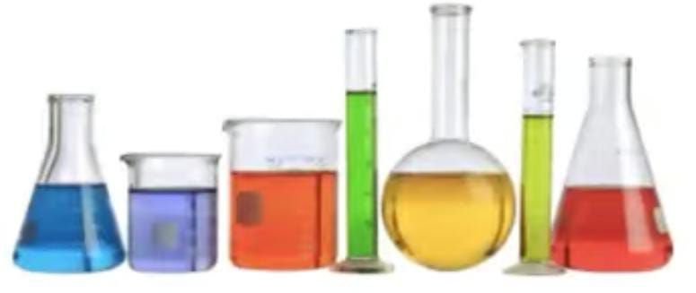
University Of Basrah College Of Pharmacy Department Of Pharmaceutical Chemistry 1st stage 1st Semester 2022-2023 Laboratory of Analytical chemistry

Slide 2
Laboratory Safety Rules, Procedures and Regulation
Introduction:
Laboratory safety rules are major aspect of every lab.
Each student in lab must follow specific safety rules and procedures.
Why is lab safety important?
Lab safety rules and symbols are needed so that students do not injure themselves or their classmates.

Slide 3
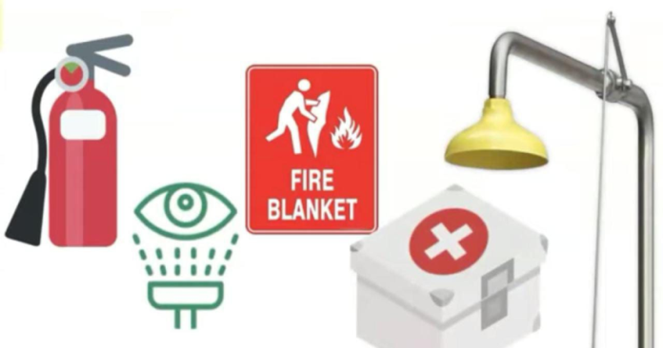
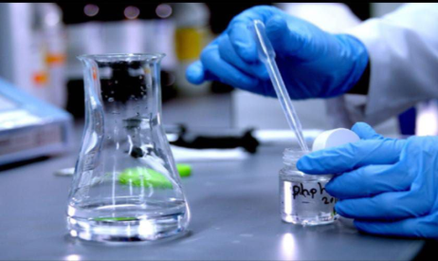
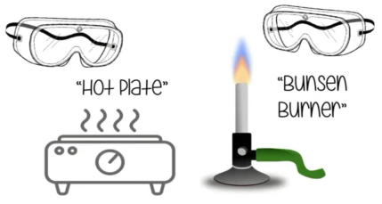
Lab Safety Rules
Rule1:- Know the location of all lab safety equipment, including the fire extinguisher, fire blanket, first aid kit, safety shower and eyewash station.
Rule2 :- Wear safety goggles, lab coat, gloves, mask and covered shoes when working, they offer additional protection against heat, flames and chemicals splash or spill.

Slide 4
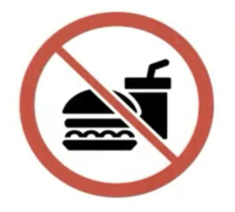
Rule3 :- All chemicals in the lab are considered dangerous. Do not touch, taste or smell any chemical unless specifically instructed to do so.
-Never use mouth suction to fill a pipette.
Rule4 :- Don’t eat or drink in the laboratory.
Rule5 :- Check the label on chemical bottles before use.
Rule6 :- Take good care when transferring acids and other chemicals from one part of the lab to another.

Slide 5
Material Safety Data Sheets (MSDS):
Include: Name of material,, Toxicity,, Storage,, Spill,, The first aid…

Slide 6
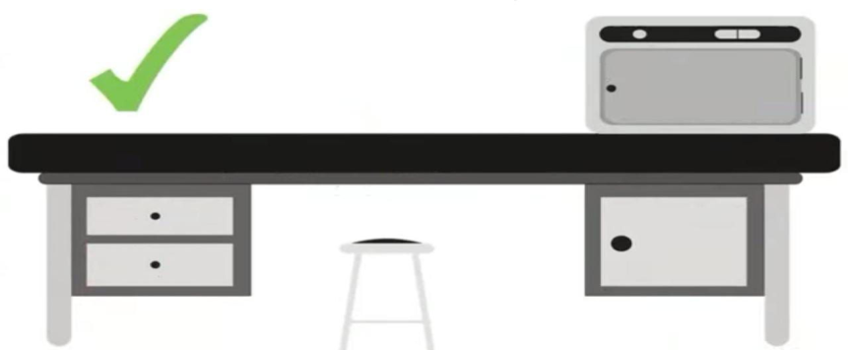
Rule7 :- Report any accident (spill, breakage, etc.) or injury (cut, burn, etc.) to your supervisor.
Rule8 :- Be tidy while working, Keep your work area clean and free of unnecessary books, papers, coats, bags and equipment.
- When an experiment is completed, clean and return all equipment to its proper place as instructed by your supervisor.

Slide 7
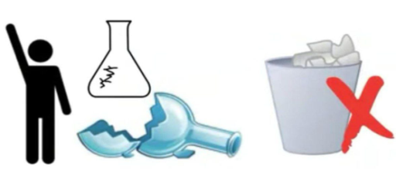
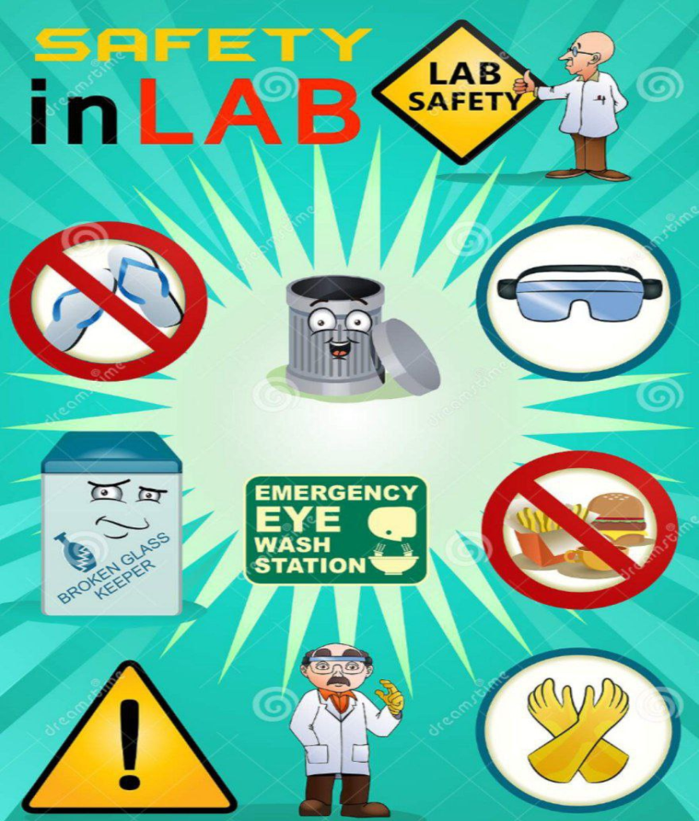
Rule9 :- Dispose the lab waste properly.
Rule10 :- Unplug all electrical sources for all devices after finishing work.

Slide 8
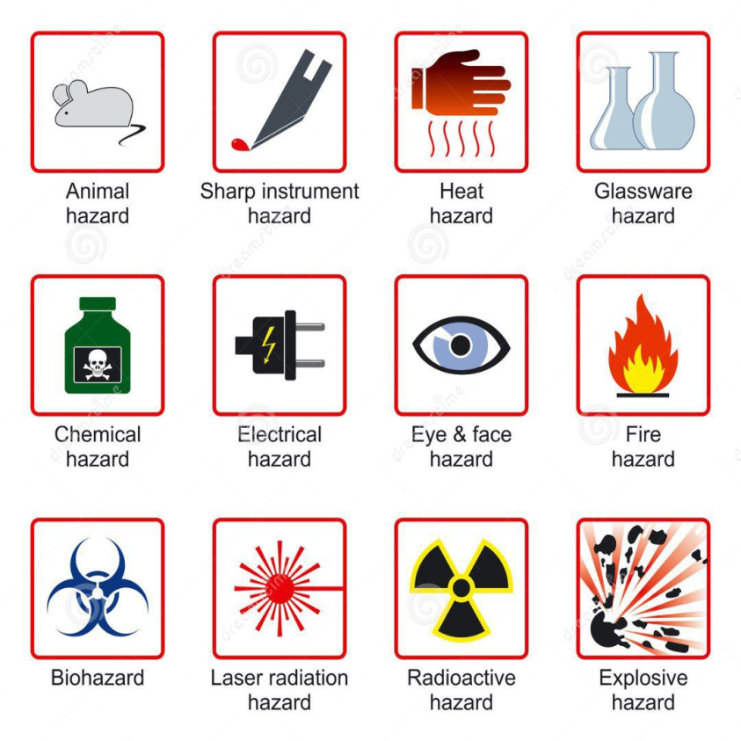
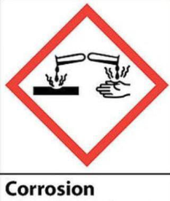
Lab Safety Symbols (Signs)

Slide 9
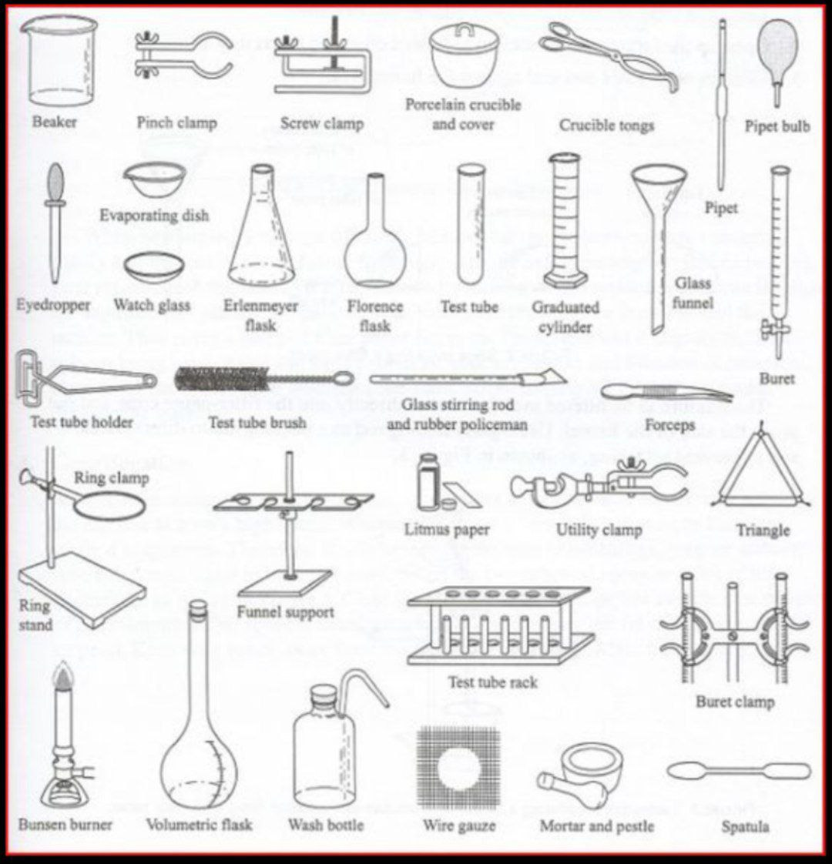
Laboratory Glassware and instruments

Slide 10
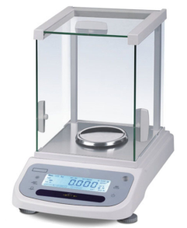
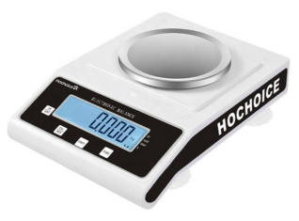
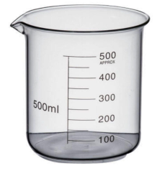
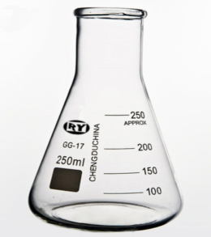
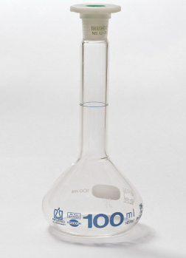
Balance : Used for measuring mass.
Beaker : Used to hold, mix and heat liquids.
Conical flask : Used for carrying out volumetric titrations, storage of liquids and mixing of solutions.
volumetric flask : Used in the preparation of solutions.

Slide 11
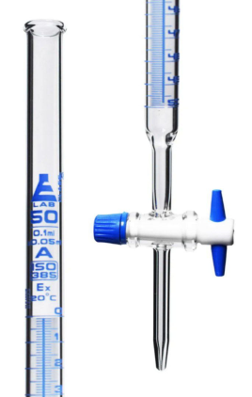
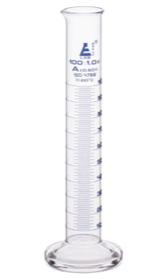
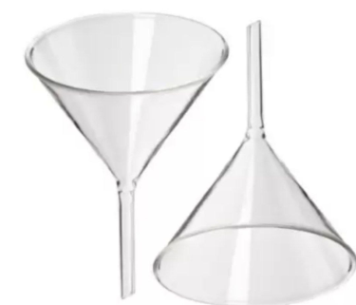
Burette :Used to measure the volume of a liquid in titrations.
Graduated Cylinder :Used to measure a precise volume of a liquid.
Funnel :Used for separating solid substances from solution, use for filtering.

Slide 12
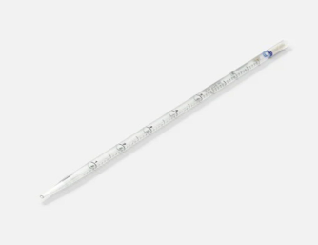
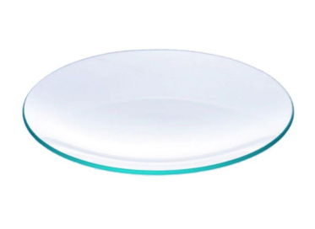
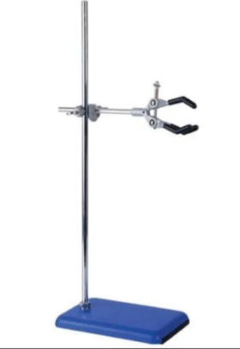
Pipette : Used to transport a measured volume of liquid.
Watch Glass : Used to hold solids while they are being weighed or to cover beaker.
Stand and Clamp : Used for hold lab glassware and other equipment in place.

Slide 13
Laboratory of Analytical chemistry
Name of experiments:
1- Safety measures and glassware.
2- Volumetric titration and respective mathematical expressions.
3- Preparation of Na₂CO₃ solution ( how to weigh a chemical substance and make a solution).
4-Neutralization titration ( acid-base titration). a) Standardization of Hydrochloric acid (HCl) with standard Sodium Carbonate (Na₂CO₃) solution .

Slide 14
b) Standardization of Sodium hydroxide (NaOH) with Hydrochloric acid (HCl).
c) Determination of percentage of Acetic acid in a Vinegar sample.
5-Precipitations titration.
6-Oxidation-redaction titration ( redox titration ).
7-Complexemetric titration.

Slide 15
Steps of Report Writing
Name of experiment :- …….
Aim of experiment :- ………
Date of experiment:- / /
Name of students:
……….
……….
……….
Introduction
Chemicals
Tools

Slide 16
Procedure
Result
Discussion for the result
1-
2-
General information
Reference
Lecturer
Jumana N. Al-Hajeri

